Slide 1
Watson Assistant Jenni Hautojärvi Client Technical Specialist IBM Cloud Lasse Huotari Client Technical Specialist Data Science & AI

Slide 2
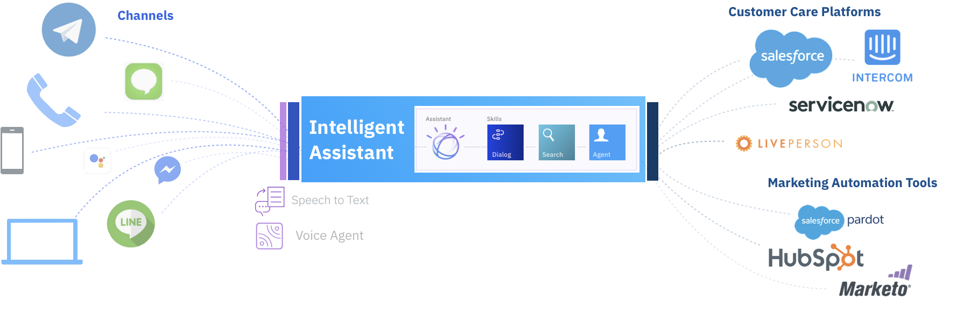
Our vision: For a given company, their customers have a branded, trusted, and personalized 'one stop shop’, for all inbound and outbound communication
Notes:
NIKLAS

Slide 3




Key Use Cases
Customer Care
Through the Watson Assistant, IBM can decrease call center operations cost, while improving the customer experience and developing new revenue streams.
Conversational Commerce
Provide guided buying experience for prospective customers to purchase goods and services through the mobile or messaging channel of their choice.
Employee Productivity
Simplify access to common questions and tasks through enterprise channels – often HR related.
3
3
3
20 November 2019
© 2018 IBM Corporation
© 2017 IBM Corporation
© 2017 IBM Corporation

Slide 4
Key Benefits
Improve User Experience
Respond to customers by avoiding ‘wait’ queues, make self service available 24/7 while providing a consistent brand experience to your customers.
Lower Operating Costs
Through Watson Assistant, IBM can decrease call center operation costs through self service and deflection of incoming queries.
Generate New Revenue Streams
Leverage Next Best Action to upsell and drive additional revenue.
Notes:
NIKLAS

Slide 5
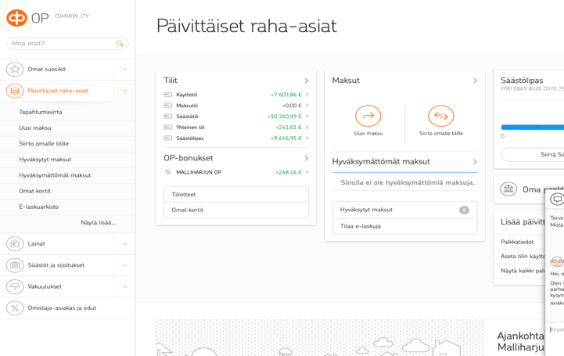


Case study at IBM.com
Opotti Chatbot
OP Financial Group is enhancing customer experience at scale with an AI-powered chatbot.
Improved customer service
Opotti responds to user interactions in seconds and frees up customer agents’ time for more complex cases requiring emotional intelligence.
Increased operational efficiency
Opotti can help countless number of customers simultaneously, therefore minimizing queues and enabling OP to scale their chat channel without having to increase the size of their customer service team.
To meet the growing demand of strategically important chat channel, OP and IBM developed a virtual agent for banking to handle incoming customer inquiries. Opotti enables customers to interact with natural language in Finnish, and get their issues resolved in no time.
Opotti has learned up to 1,000 answers in multiple areas e.g. accounts, payments, loans, investments, and online services. The basis for Opotti’s Agile development was a customer oriented approach which emphasized seamless cooperation between Opotti and his human colleagues.

Slide 6
Watson helps car owners quickly and easily access accurate information about their vehicles
Daimler AG and IBM have jointly developed the virtual assistant, “Ask Mercedes,” based on IBM Watson conversational technology and the IBM Cloud. Mercedes’ goal is to ensure that all drivers are able to quickly and easily access accurate information about their vehicles.
Users can pose questions specifically about their vehicle, as they would to a knowledgeable Mercedes expert, and can also ask general question about Mercedes features, such as the new EQ design for Mercedes electric vehicles.
Ask Mercedes is designed to help both Mercedes owners and also users of car sharing or rental services.
© 2018 IBM Corporation 20 November 2019 Confidential
Notes:
LASSE
https://www.youtube.com/watch?v=nFct6mUNmAw
“The messaging part is a product we’ve been working with for a number of years from a company called LivePerson. They’re the leading provider of messaging and chat technologies, and we’ve incorporated the latest version of their software into our app. The pilot platform is currently powered by a combination of IBM Watson and LivePerson. In a blend of the two cutting edge technologies, IBM Watson provides the artificial intelligence solution to power TOBi.”

Slide 7


Knowledge Management
IBM IP EC&O
Retain 30 years of documented knowledge
IBM partnered to build a knowledge base using Watson on all project lessons learned over decades of executing projects.
Trained by the companies highly experienced engineering experts, capturing their many years of experience and by providing answers from over 20,000 documents.
Access to past project history enabled engineers to ask complex questions in natural language and helps in retention of corporate memory
70 Miles From Shore with Watson: Woodside Energy and IBM
https://www.youtube.com/watch?v=GFZ2IaTVkY8
Meet our avatar, Willow
https://youtu.be/6WmgCu8zeVc
Watson at Work 360: Natural Gas Plant Operated by Woodside
https://youtu.be/KuqvQr7DiTQ
Watson technology culls through 30 years of Woodside’s documented knowledge.
Engineers augment their expertise with a virtual advisor, “Lesson Learned.”
Each outcome is added to collective knowledge, informing future decisions.

Slide 8
How to start building digital assistants?

Slide 9
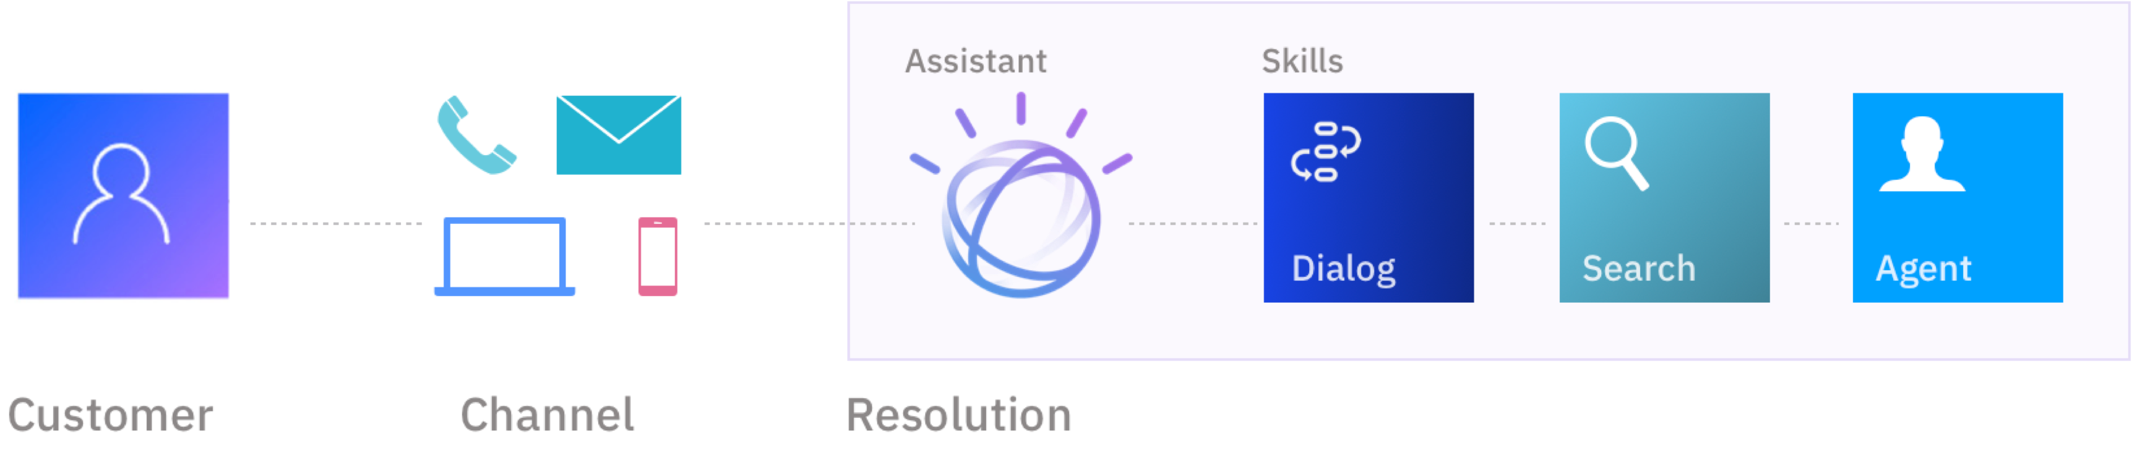
Watson Assistant Intent-driven, not rules
Watson Assistant understands the user's intent by utilizing the latest Deep learning techniques. Learns over time based on usage.
Notes:
Used to create conversation flows between your apps and your users
Assistants allow you to create integrations that publish your chatbot to the channels where your users go for help
machine learning
natural language understanding
integrated dialog tools

Slide 10
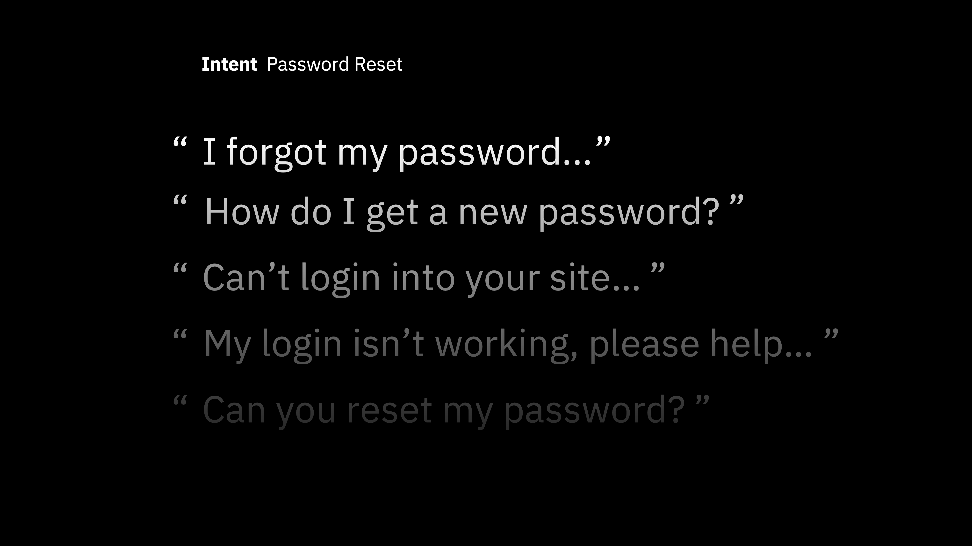
Notes:
Intents are a purpose or goal expressed by a user’s input
recognise user’s intent => choose the correct dialog flow / response
provide Watson Assistant with multiple examples (train)

Slide 11
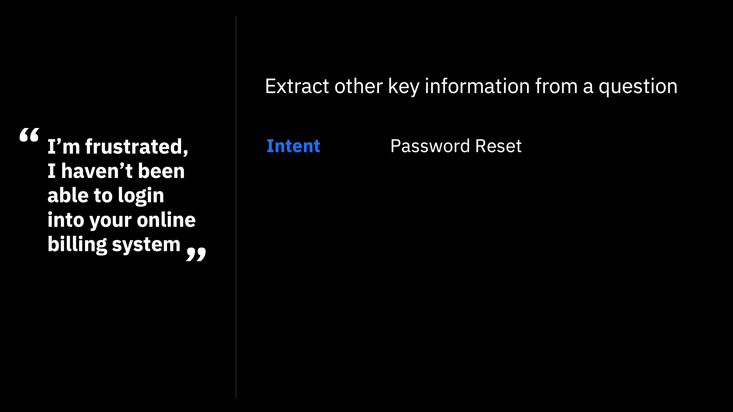
Notes:
Aikomus salasanan resetointi

Slide 12
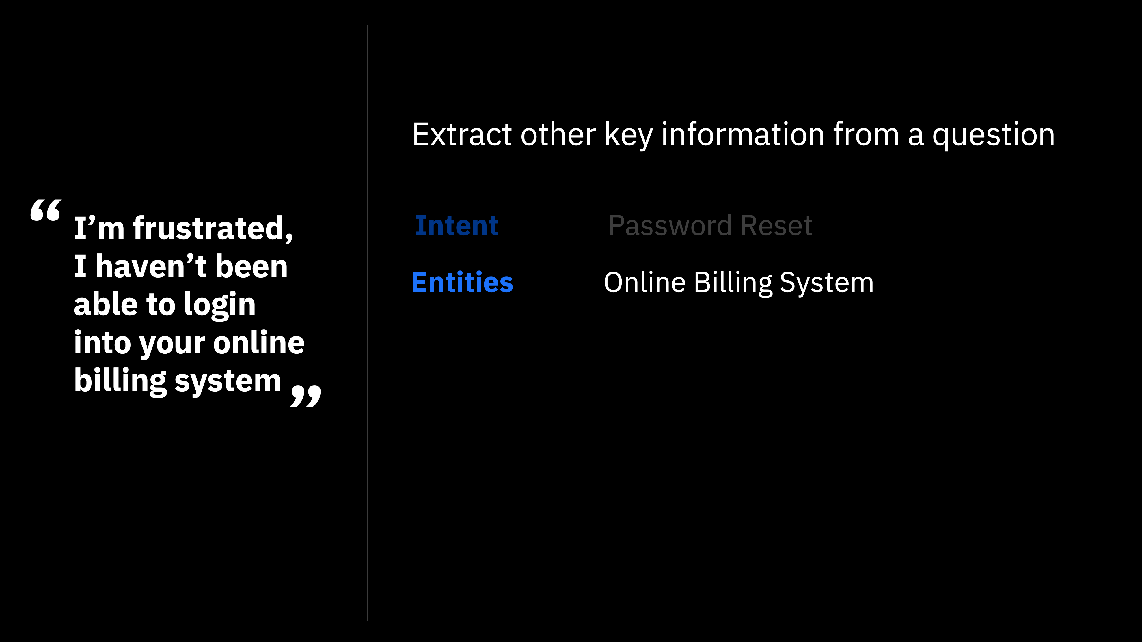
Notes:
Entities represent a class of object or a data type
can be used to trigger different responses, even for same intent

Slide 13
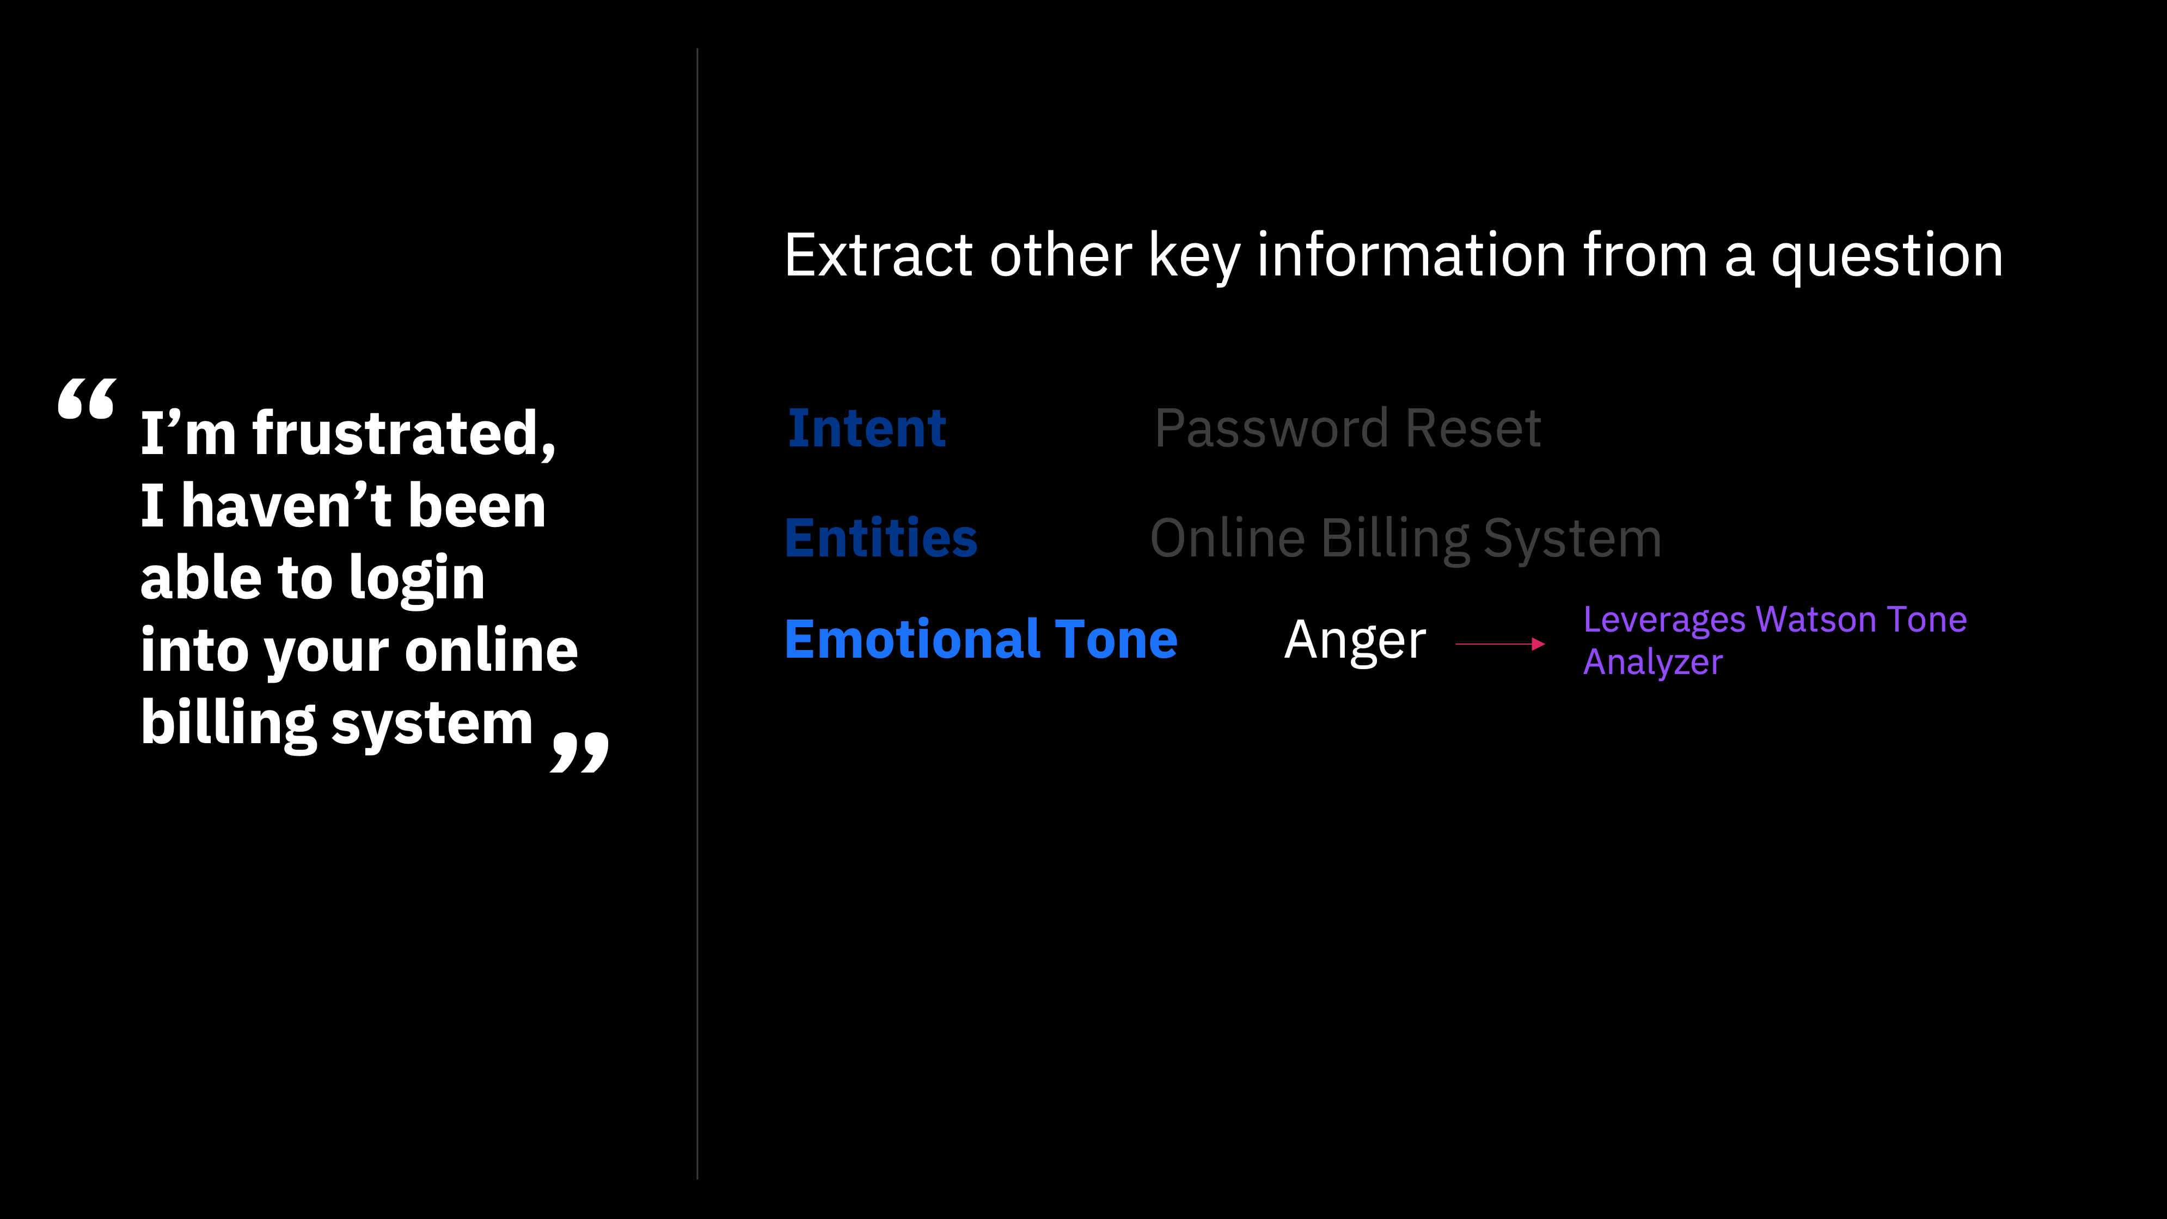

Slide 14


Chatbot: Question Distribution
Watson
Assistant
Here Watson uses reasoning strategies that focus on the language and context of the question.
How do I get a Visa?
I need to visit Zimbabwe as a British citizen with a criminal record—can I do that?
Frequency of Questions
Watson Discovery
Here Watson uses reasoning strategies that focus on identifying the most appropriate answer.
Short Tail
Long Tail
100s
100,000+
Unique Intents
Notes:
- We will use Watson Assistant and Watson Discovery to
answer both short-tail and long-tail questions
- Short-tail questions are typically more PREDICTABLE and
FREQUENT, and will be dealt with by Assistant
- Long-tail questions are typically more SPECIFC, and
retrieved from a KNOWLEDGE BASE, which we will do here
with Discovery

Slide 15


Lab 1: Cognitive Chatbot Basics
Create a basic chatbot to help guide you when buying a new mobile phone
Watson Assistant
Notes:
Setup a Watson Assistant instance
Create a skill
Create intents, entities
Create a dialog tree utilising both intents and entities
Test your chatbot
Adding rich content: sending images

Slide 16

Lab 2: Chatbot Integrations
Use Watson Assistant integrations to access your chatbot using:
a web-hosted chat widget you can use for testing
a live, publicly available web-hosted version of your chatbot
Notes:
Create an Assistant for your skill
Create a Preview Link: a web widget to test your chatbot
Setup a live web-hosted chatbot

Slide 17
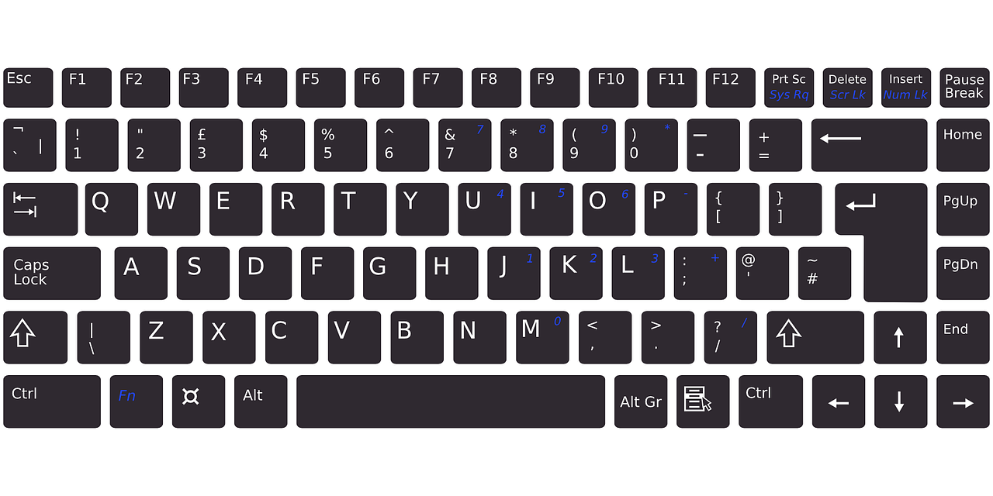
Lab 3: Understanding User Sentiment Integrating Watson Natural Language Understanding
Extend your chatbot to provide a new function
Allow the user to submit a review of a phone and respond based on user sentiment
Use Watson Assistant option response to prompt the user
Introduce Watson Natural Language Understanding (NLU)
Sentiment analysis
Emotion analysis
Extracting entities, keywords and concepts
Use IBM Cloud Functions to integrate Watson NLU into your chatbot
Notes:
Setup an IBM Watson NLU instance
Create Sentiment Analysis IBM Cloud Function
Setup Watson Assistant to use IBM Cloud Functions
Create Submit Review intent and dialog

Slide 18
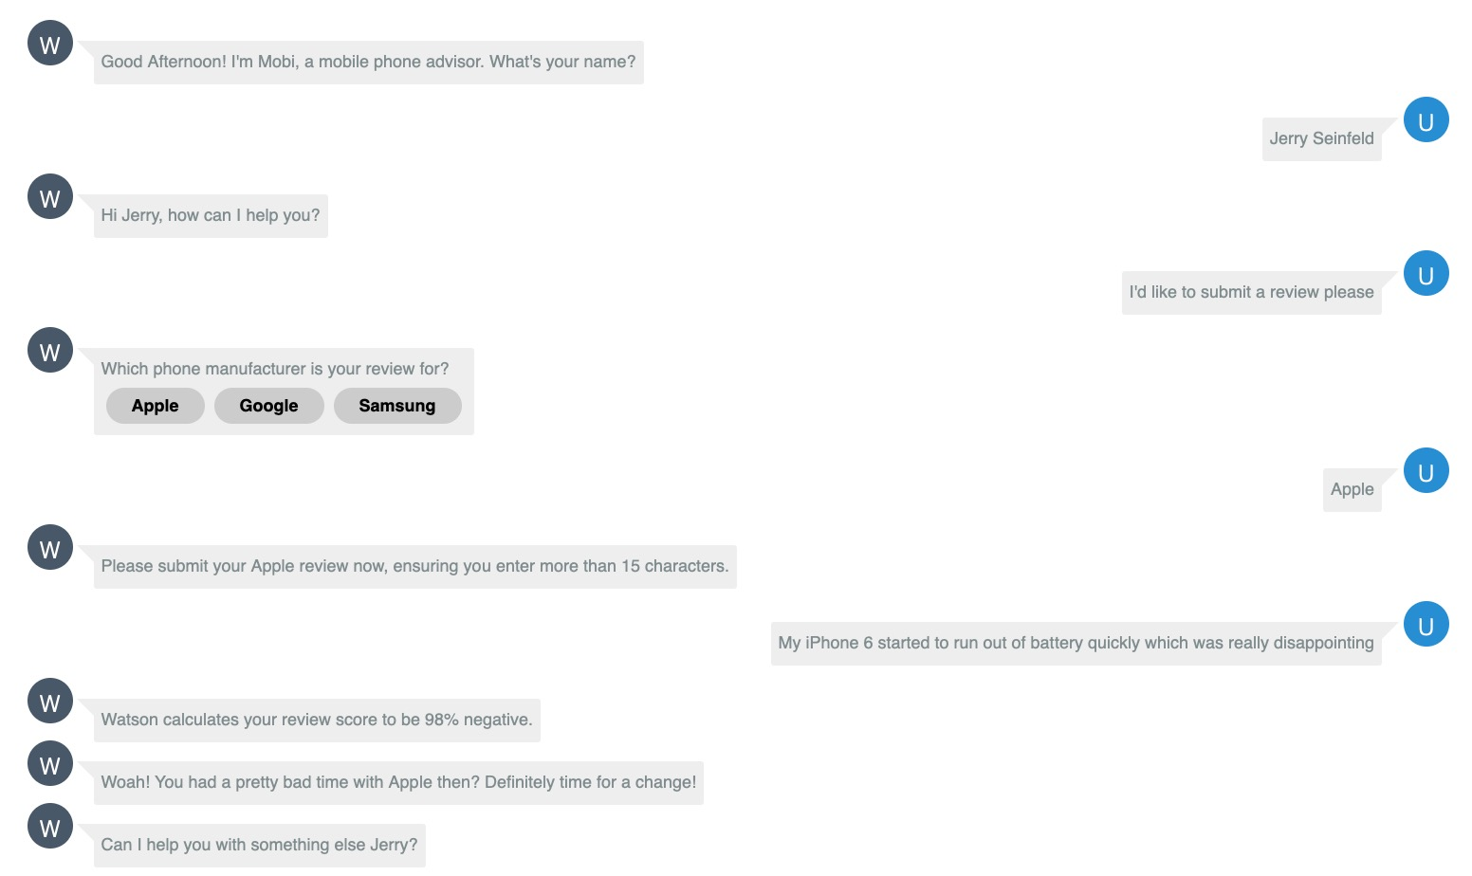
Watson Natural Language Understanding
Passed to NLU
Response based on sentiment

Slide 19
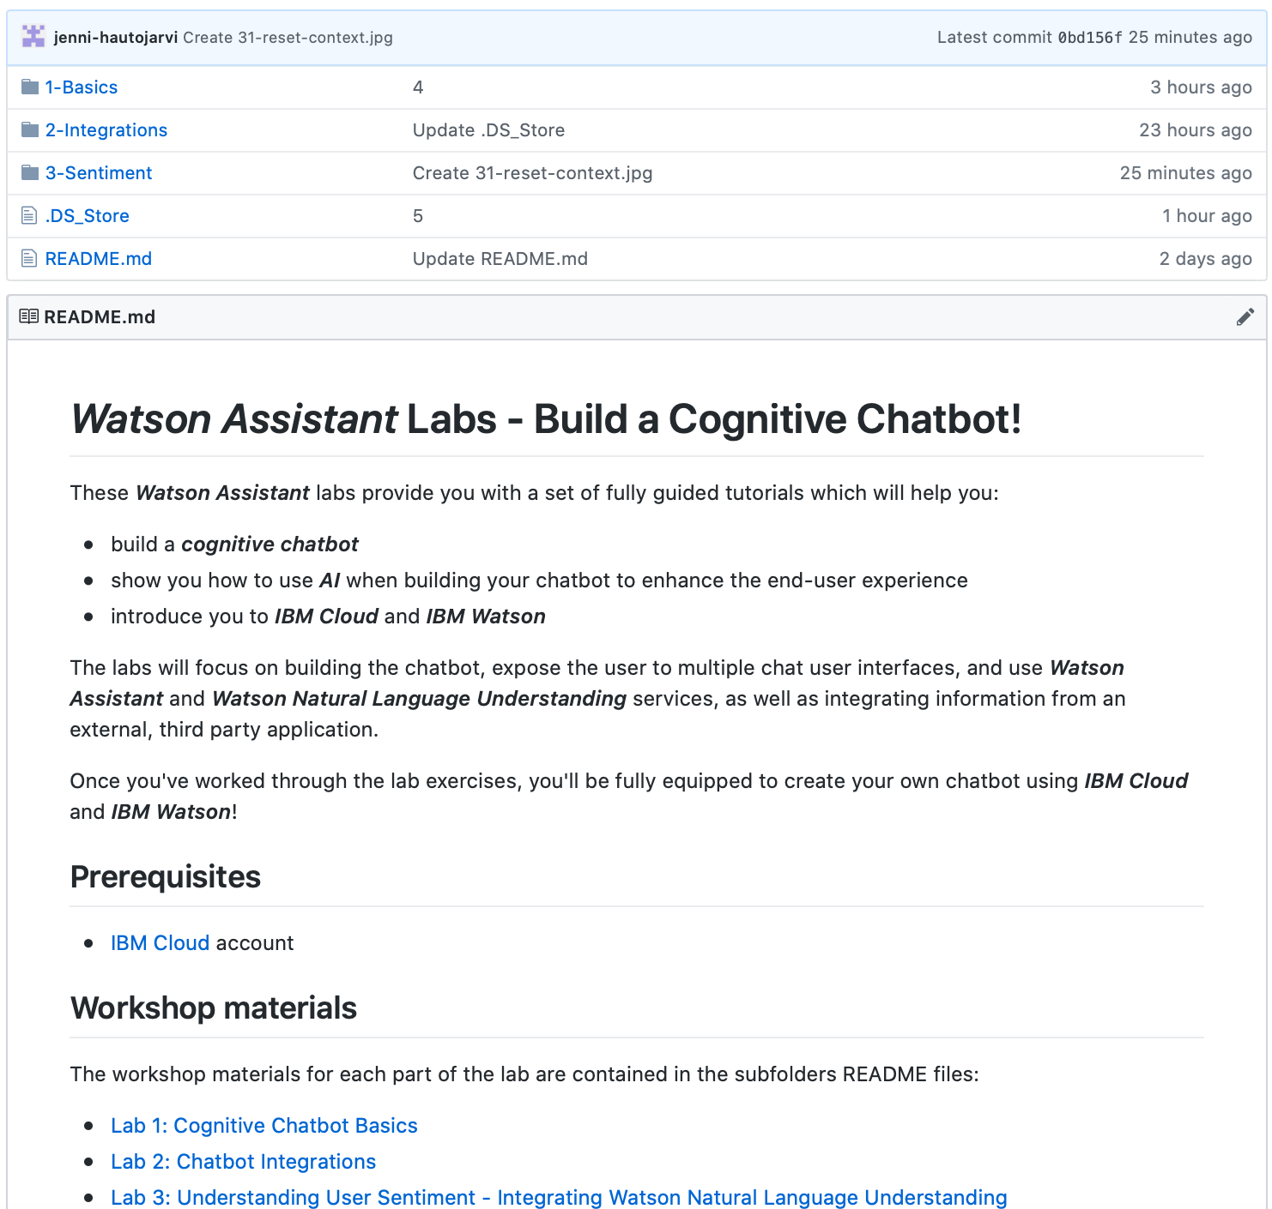
Lab Format
Step-by-step instructions
GitHub README.md for each lab
Work at your own pace
https://github.com/jenni-hautojarvi/Watson-Assistant-Labs

